Slide 1

7th Grade Accelerated Math Unit 1, Lesson 2 Converting Between Repeating Decimals and Fractions Volume 1, pg. 12

Slide 2


Benchmark
MA.7.NSO.1.2
Rewrite rational numbers in different but equivalent forms including fractions, mixed numbers, repeating decimals, and percentages to solve mathematical and real-world problems.
volume 1, pg. 12

Slide 3
Integrated Mathematical Thinking and Reasoning Standards
MA.K12.MTR.4.1 Engage in discussions that reflect on the mathematical thinking of self and others.
MA.K12.MTR.5.1 Use patterns and structure to help understand and connect mathematical concepts.
volume 1, pg. 12

Slide 4

Learning Target
I can rewrite rational numbers in different but equivalent forms, including repeating decimals.
volume 1, pg. 12

Slide 5

Warm-Up
volume 1, pg. 13

Slide 6
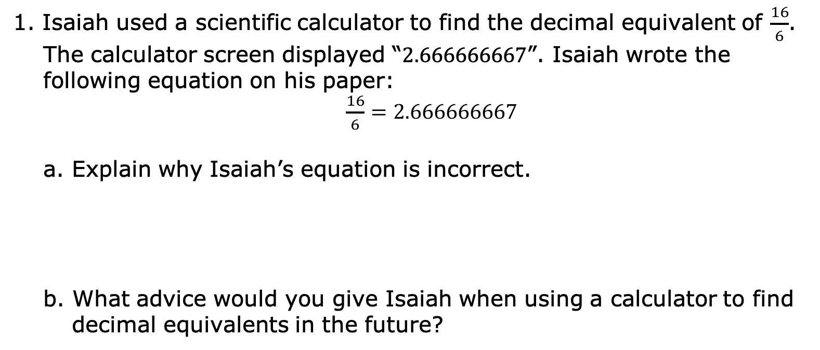
1.2.1 Warm-Up: Error Analysis
1. Isaiah used a scientific calculator to find the decimal equivalent of $\frac{16}{6}$. The calculator screen displayed “$2.666666667$”. Isaiah wrote the following equation on his paper:
$\frac{16}{6}=2.666666667$
a. Explain why Isaiah’s equation is incorrect.
b. What advice would you give Isaiah when using a calculator to find decimal equivalents in the future?
volume 1, pg. 13

Slide 7

Guided Instruction
volume 1, pg. 13

Slide 8
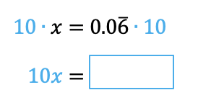
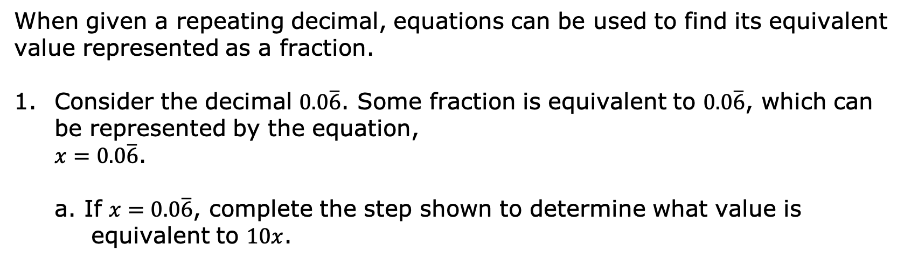
1.2.2 Guided Instruction: Rewriting Repeating Decimals as Fractions
When given a repeating decimal, equations can be used to find its equivalent value represented as a fraction.
Consider the decimal $0.0\overline{6}$. Some fraction is equivalent to $0.0\overline{6}$, which can be represented by the equation,
$x=0.0\overline{6}$.
a. If $x=0.0\overline{6}$, complete the step shown to determine what value is equivalent to $10x$.
volume 1, pg. 13

Slide 9
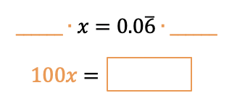
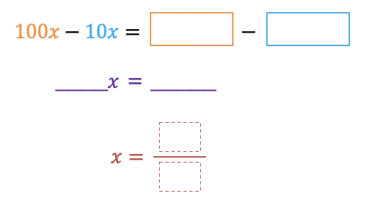

b. Determine what value is equivalent to $100x$.
c. These relationships can be used to find the value of $x$ represented as a fraction. Complete the steps shown.
d. Rewrite the solution as a fraction in simplest form.
volume 1, pg. 13

Slide 10
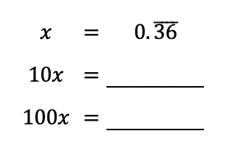

2. Consider the repeating decimal $0.\overline{36}$.
If $x=0.\overline{36}$, complete each equation.
Which two values, when subtracted, would result in the repeating portion of the decimal being eliminated?
volume 1, pg. 14

Slide 11
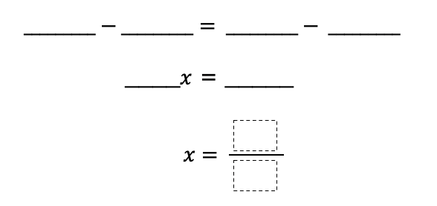

c. Use two of the relationships represented in the equations in Part A to complete the steps to find the fraction equivalent of $0.\overline{36}$.
d. Rewrite the solution as a fraction in simplest form, if possible.
volume 1, pg. 14

Slide 12

Guided Practice
volume 1, pg. 14

Slide 13

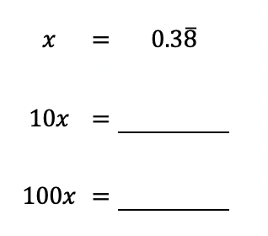

1.2.3 Guided Practice: Rewriting Repeating Decimals as Fractions
Consider the repeating decimal $0.3\overline{8}$.
a. If $x=0.3\overline{8}$, complete each equation.
b. Which two values, when subtracted, would result in the repeating portion of the decimal being eliminated?
volume 1, pg. 14

Slide 14
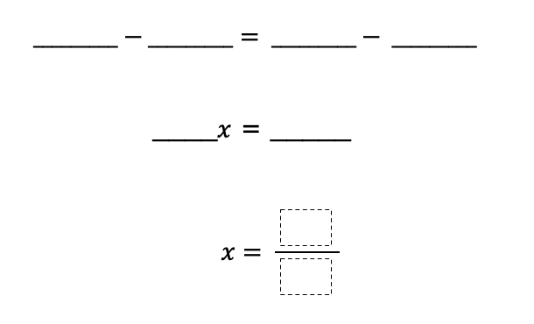

c. Use two of the relationships represented in the equations in Part A to complete the steps to find the fraction equivalent of $0.3\overline{8}$.
d. Rewrite the solution as a fraction in simplest form, if possible.
e. Write the fraction or mixed number that is equivalent to $14.3\overline{8}$.
volume 1, pg. 14

Slide 15

Collaboration
volume 1, pg. 15

Slide 16

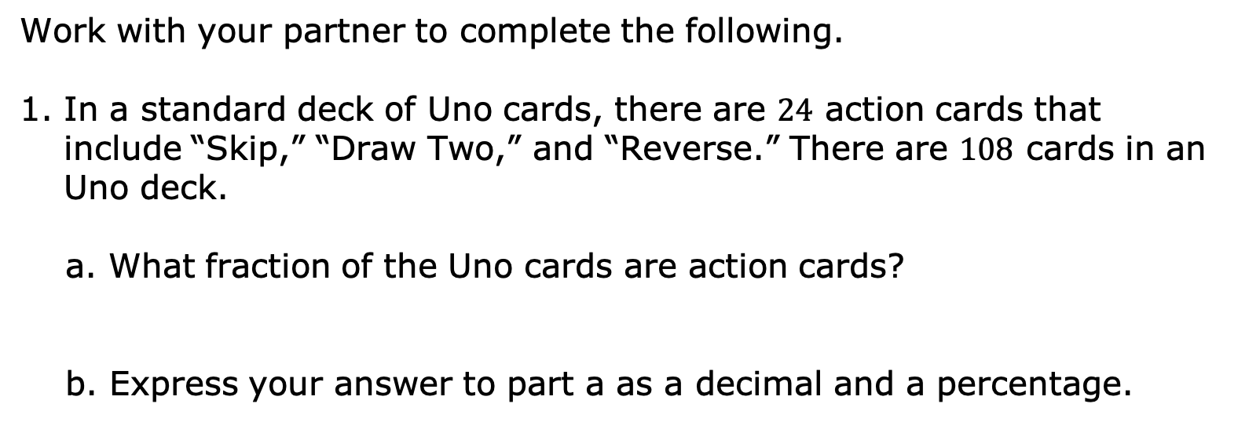
1.2.4 Collaboration: Fractions, Decimals, and Percentages
Work with your partner to complete the following.
In a standard deck of Uno cards, there are $24$ action cards that include “Skip,” “Draw Two,” and “Reverse.” There are $108$ cards in an Uno deck.
What fraction of the Uno cards are action cards?
b. Express your answer to part a as a decimal and a percentage.
Decimal | Percent
volume 1, pg. 15

Slide 17
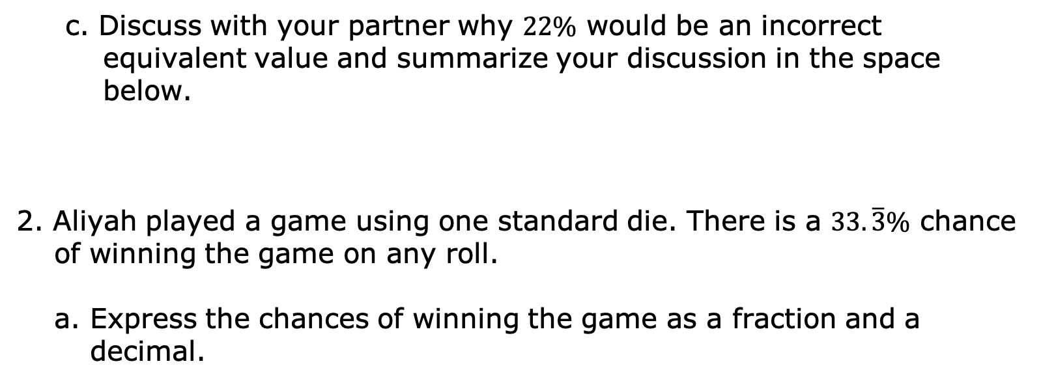
c. Discuss with your partner why $22\%$ would be an incorrect equivalent value and summarize your discussion in the space below.
2. Aliyah played a game using one standard die. There is a $33.\overline{3}\%$ chance of winning the game on any roll.
a. Express the chances of winning the game as a fraction and a decimal.
Decimal | Fraction
volume 1, pg. 15

Slide 18
b. Which representation – decimal, fraction, or percentage – is the easiest way to describe the chance of a winning roll?
c. What are the possible results in the sample space when rolling a standard six-sided die?
d. Discuss with your partner what you think the rules of Aliyah’s game might be. Then, complete the statement with one possibility.
To win the game, Aliyah must roll ______________
_________________________________________
________________________________________.
volume 1, pg. 16

Slide 19

Your Turn
volume 1, pg. 16

Slide 20
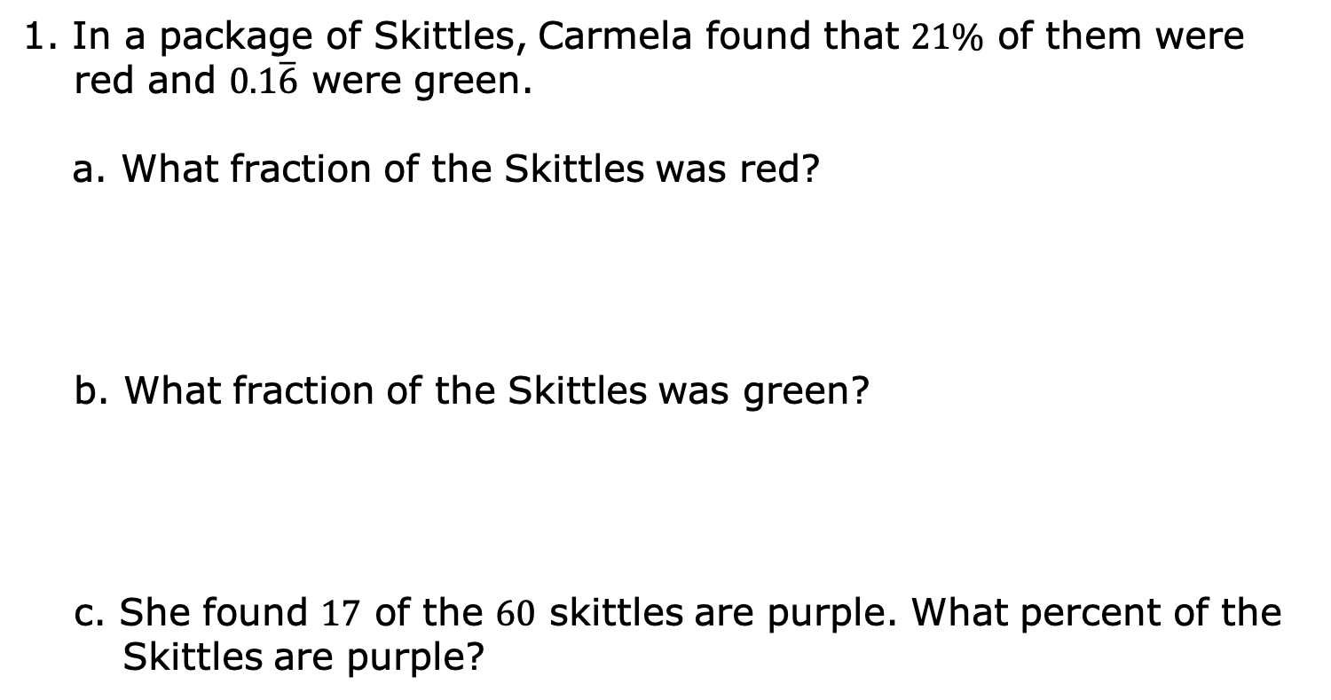
1.2.5 Your Turn!
1. In a package of Skittles, Carmela found that $21\%$ of them were red and $0.1\overline{6}$ were green.
What fraction of the Skittles was red?
b. What fraction of the Skittles was green?
c. She found $17$ of the $60$ skittles are purple. What percent of the Skittles are purple?
volume 1, pg. 16

Slide 21

Wrap-Up
volume 1, pg. 17

Slide 22
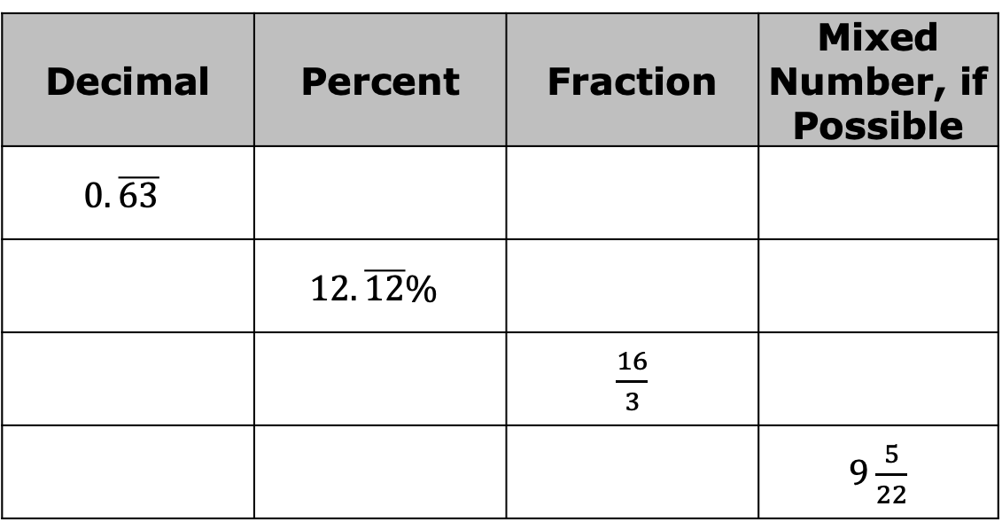
1.2.6 Wrap-Up: Ticket Out the Door
1. Complete the table.
Decimal | Percent | Fraction | Mixed Number, if Possible
$$0.\overline{63}$$
 | $$12.\overline{12}\%$$
 |  | $\frac{16}{3}$
 |  |  | $9\frac{5}{22}$
volume 1, pg. 17

